Slide 1

The 20th Century

Slide 2
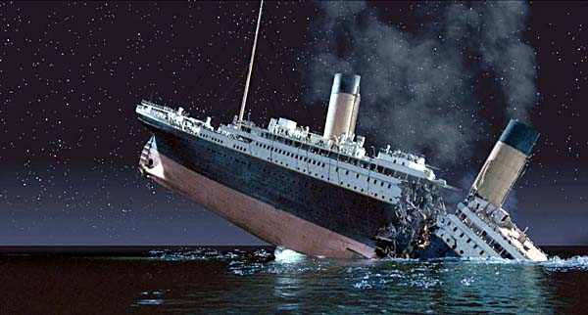
The Titanic
Short Video ---https://www.youtube.com/watch?v=FSGeskFzE0s
RMS Titanic was a British passenger liner that sank in the North Atlantic Ocean in the early morning of 15 April 1912, after colliding with an iceberg during her maiden voyage from Southampton, UK, to New York City, US. The sinking resulted in the deaths of more than 1,500 passengers and crew,

Slide 3
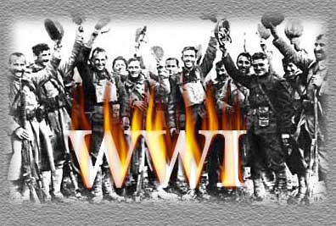
World War I---1st World War in history
Great War or War to End all War
Not called WWI until after WWII
Total war
Involved 60 nations and 6 continents

Slide 4
Cost of War$400 billion
$10 million dollars an hour
16 million deaths
First war of the Industrial Revolution……
New Weapons vs old tactics of fighting

Slide 5
The Real Causes of the War
Imperialism- European powers were going to all parts of the world to gain land.
Africa, Asia, The Pacific
By 1910, the most desirable colonies had been taken.
Germany envied France and Britain b/c they had the richest colonies.
They soon realized that the only way to get land in Africa was to take it away from the colonizers.

Slide 6
Militarism/Nationalism
Building up a nation’s military for war and giving them more power than the government.
Austria-Hungary, France, Germany, Great Britain, Russia
Spend large sums of money on new weapons and warships.
All of these countries were preparing for war.

Slide 7
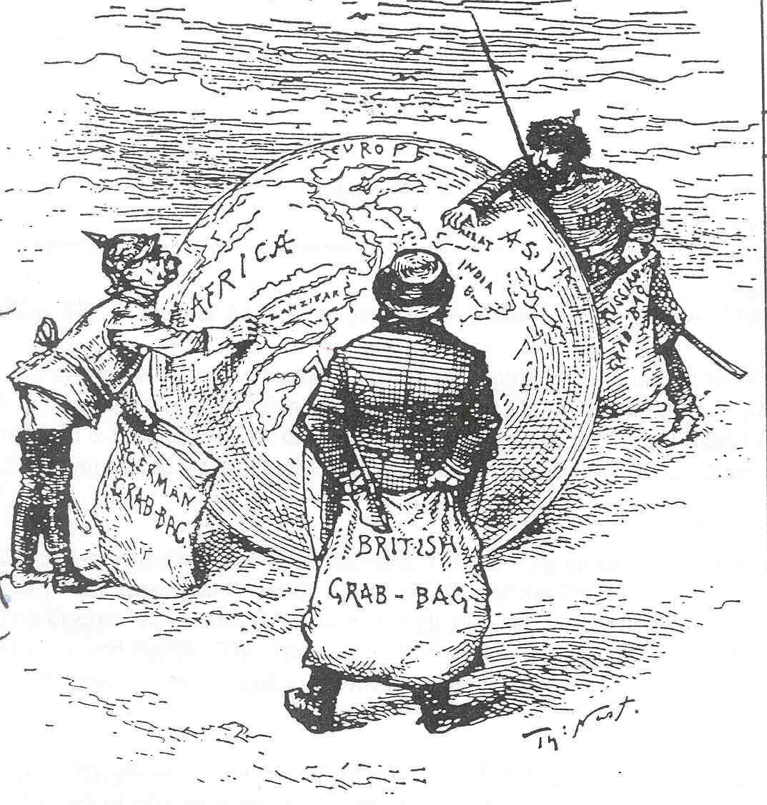
Cartoon-European grab bag
A BIG CAUSE OF WORLD WAR I
European nations competing for colonies around the world…..Imperialism

Slide 8
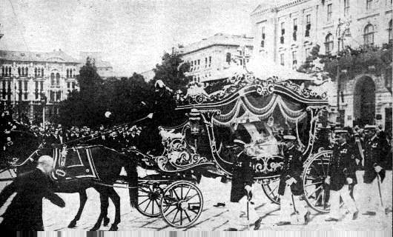
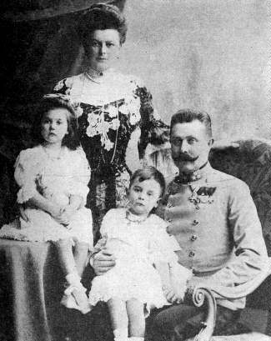

franz
How WWI Got Started: Assassination of Franz Ferdinand
Franz Ferdinand’s funeral procession
Archduke Franz Ferdinand and his family. Archduke was heir to the throne in the Austrian Hungarian Empire. His assassination June 28, 1914 eventually led to WWI.
Garvillo Princip, a Serbian nationalist assassinated the Archduke. He was trying to gain allowances for his fellow Serbs who lived under Austrian rule.

Slide 9
Alliance Chain Reaction
When the Archduke was assassinated, Bosnia along with Serbia were annexed to Austria-Hungary.
Austria-Hungary was convinced Serbia has something to do with the killings.
They used this excuse to declare war on Serbia on July 28, 1914.
This set off the chain reaction of alliances throughout Europe.

Slide 10
Alliances
European nations began forming military alliances with one another to maintain a balance of power ……..
Triple Alliance Triple Entente
Central Powers Allied Powers
Germany Great Britain Austria-Hungary Empire France
Bulgaria Russia

Slide 11
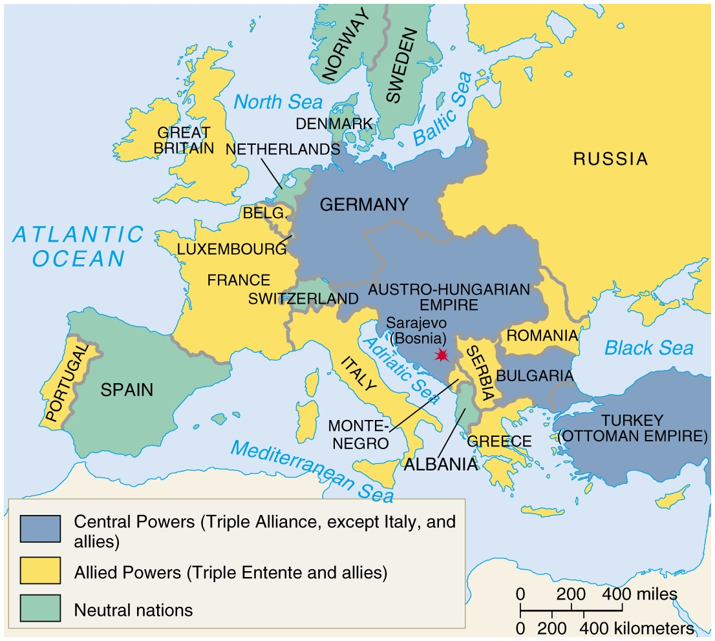

Slide 12
Deadly Technology
Machine guns and rapid fire artillery
Grenades
Submarines
Poison Gas
Air Planes
Zeppelins
Tanks
Battle of Somme in 1916 British troops lost 20,000 troops in one day.

Slide 13
Trench Warfare
Trench foot
Contracted lice from rats
Constant fear
No man’s land
Casualties (French had 1,000,000 casualties in first 3 months of war)

Slide 14
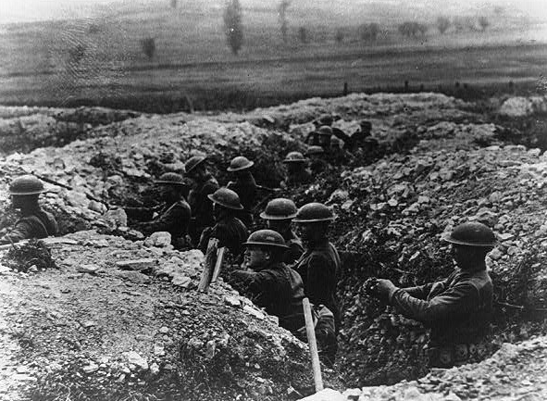
TRENCH WARFARE

Slide 15
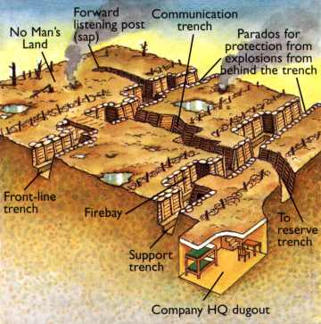
Trench Warfare

Slide 16
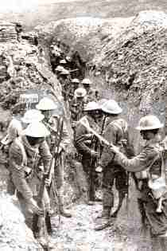
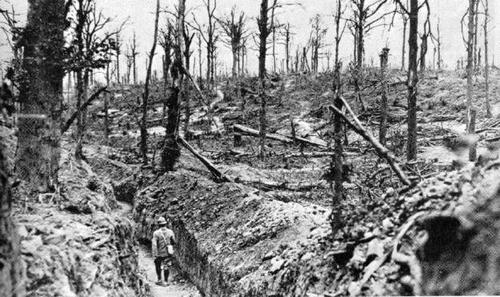
Four minute really good video about effect of WWI on the entire 20th century.--- http://www.history.com/topics/world-war-i/world-war-i-history/videos/the-one-thing-you-should-know-about-wwi

Slide 17
US IN 1914
Panama Canal was completed in August of 1914 just a week before WWI began in Europe.
Woodrow Wilson became President in 1912.
Americans were shocked by the outbreak of war but…………..it was in Europe.
US was officially NEUTRAL

Slide 18
German Submarine Warfare
U-Boats- Britain and Germany competed to build the largest and strongest navy.
Germany blockaded Britain by navy.
Propaganda used by Britain to sway U.S. opinion.
Lusitania- 128 Americans killed
Germany agreed to stop blowing up passenger ships.
March 24,1916 Sussex was sunk by Germans

Slide 19
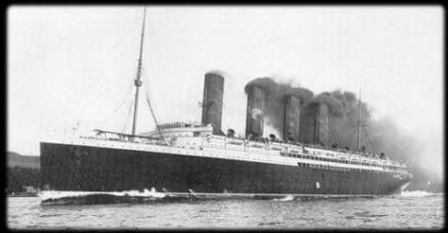
SINKING OF THE LUSITANIA
May 7, 1915, the Germans sunk the Lusitania which was British passenger liner.
Germans believed it was carrying contraband (weapons) to the British.
Killed 1,198 civilians including 128 Americans.
U.S. and other countries outraged towards Germany because of “unrestricted submarine warfare”.
US believed the Germans had violated international law of targeting civilians

Slide 20
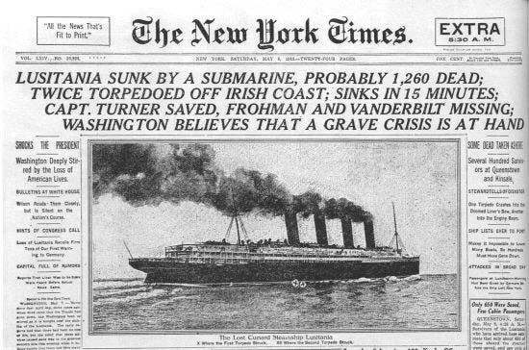
4 Minute Short Video on Lusitania, Made in 1918 --- https://www.youtube.com/watch?v=AYKdXABWaFg

Slide 21
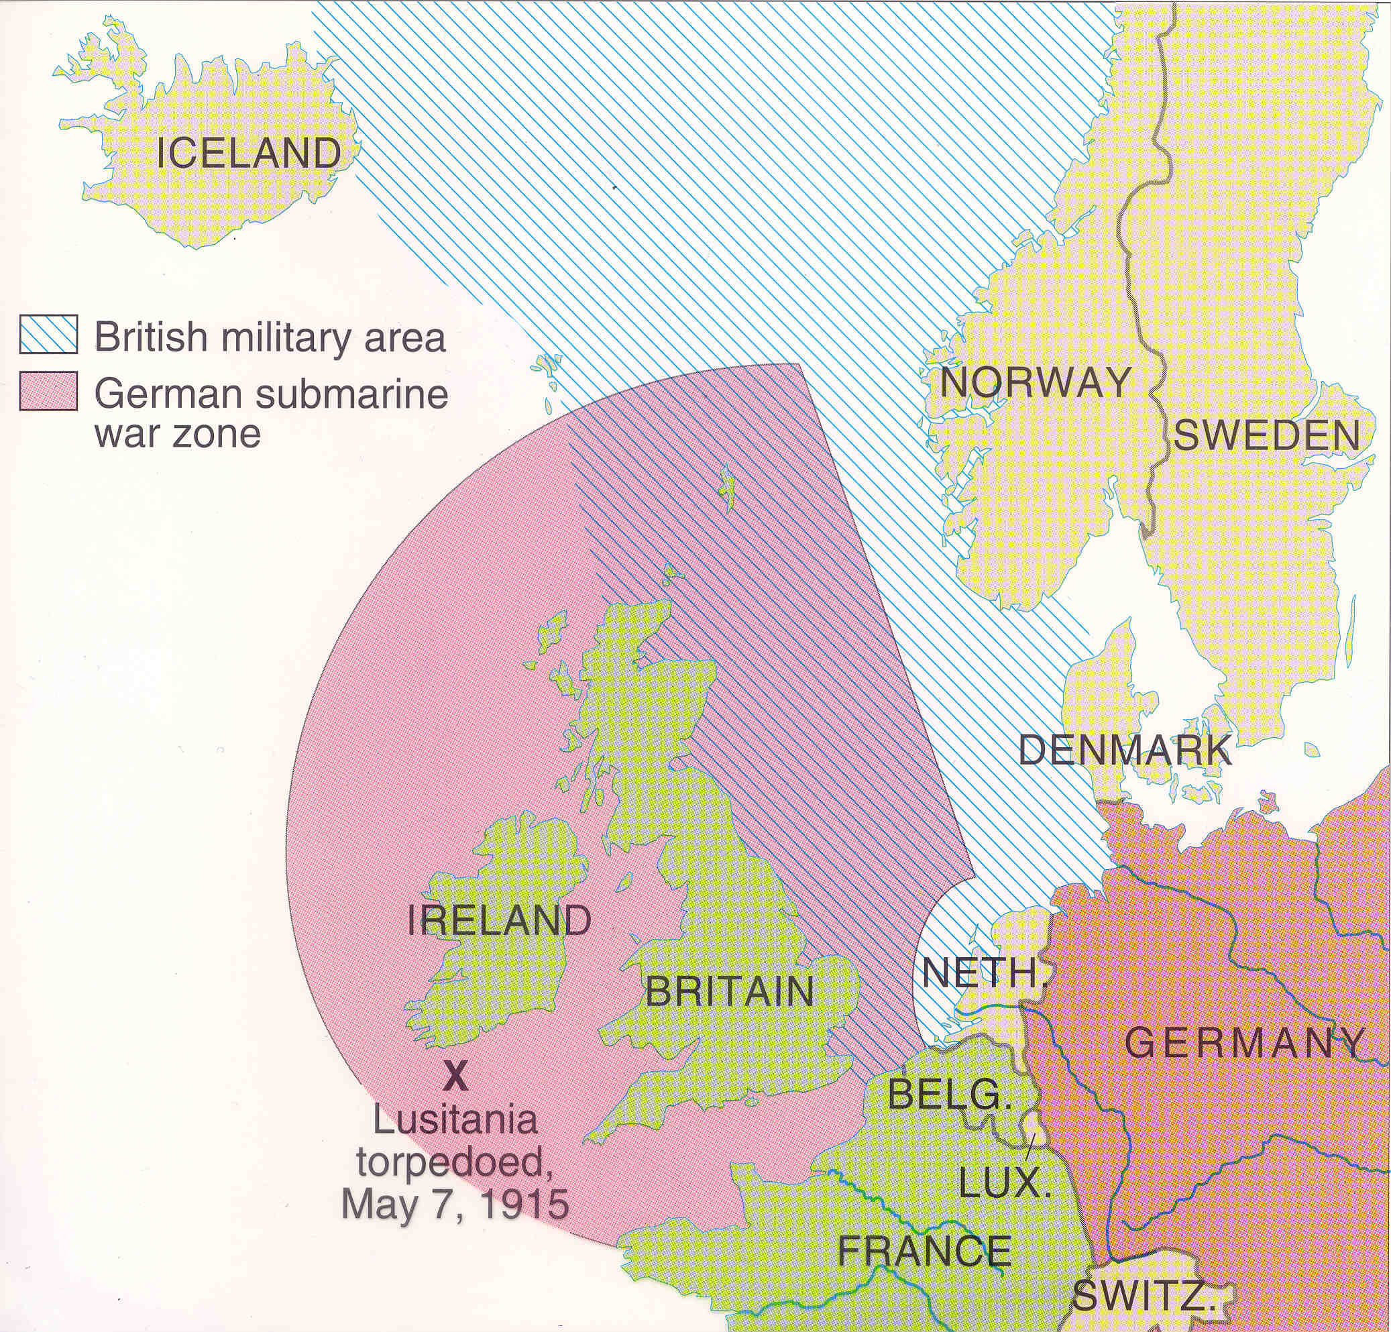
war zone

Slide 22
American Opinions
3 groups
Isolationists- Stay out of war
Interventionists- U.S. should intervene on side of Allies
Internationalists- Get involved only to solve the problem and promote peace.

Slide 23
America Enters the War
Feb. 3, 2016 --- U.S. cuts off diplomatic ties with Germany.
Zimmerman Note- Germany promises lost land to Mexico if they declare war on U.S.
Finally, on April 6, 1917, the U.S. joined its allies--Britain, France, and Russia--to fight in World War I. Under the command of Major General John J. Pershing, more than 2 million U.S. soldiers fought on

Slide 24
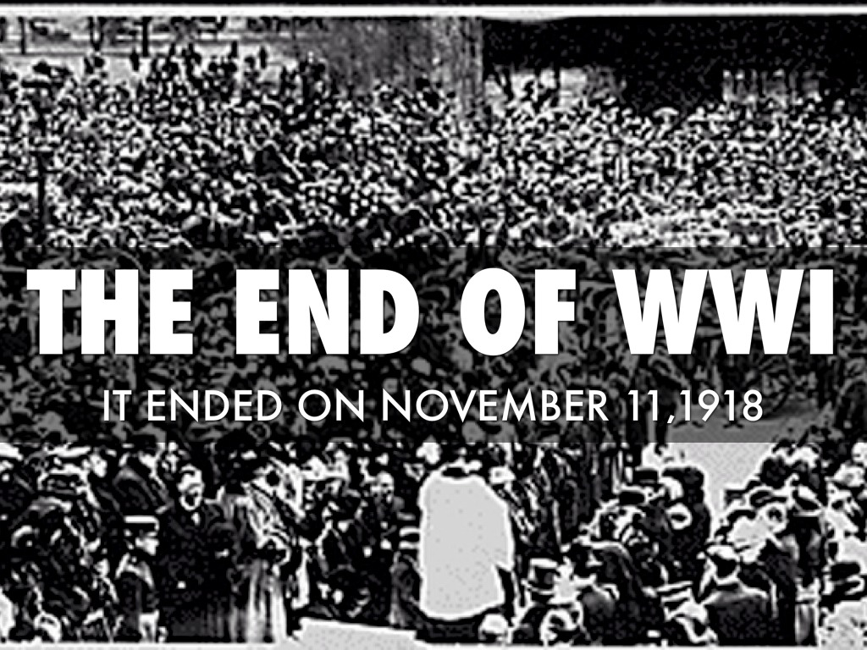
End of WWI
The End of the Great War
By the end of the Hundred Days Offensive, the German forces were exhausted and running out of food and supplies. On November 11, 1918 they requested an armistice. An armistice is when both sides agree to stop fighting while a peace treaty is negotiated. The Allies agreed to the armistice and at 11 AM on November 11, 1918 the fighting in World War I came to an end.
Treaty Negotiations
The Allied Nations met in Paris at the Paris Peace Conference in 1919 to decide the fate of Germany and the Central Powers. Although a number of nations took part in the negotiations, the major decisions and discussions were between the leaders of the "Big Four" nations which included Georges Clemenceau (Prime Minister of France), David Lloyd George (Prime Minister of Great Britain), Woodrow Wilson (President of the United States), and Vittorio Orlando (Prime Minister of Italy).

Slide 25

League of Nations
January 10,1920 --- As part of the Paris Peace Conference, an organization called the League of Nations was formed. The League of Nations was formed in an effort to establish world peace. Its member countries hoped to prevent wars by helping to settle disputes between countries. The League also aimed to establish fair labor conditions, improve global health, control the global arms trade, and protect minorities in Europe. The League was officially founded by the Treaty of Versailles and had 42 founding member countries.

Slide 26

The Roaring Twenties
The Roaring Twenties is a term for the 1920s in the Western world. It was a period of sustained economic prosperity with a distinctive cultural edge in the United States, Canada, and Western Europe, particularly in major cities such as New York, Montreal, Chicago, Detroit, Paris, Berlin, London, and Los Angeles.

Slide 27
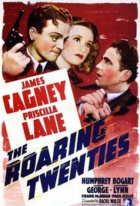
The Roaring Twenties
The Jazz Age was a post World War I movement in the 1920's, from which jazz music and dance emerged. Although the era ended with the beginning of The Great Depression in the 1930's, jazz has lived on in American pop culture.
Good six minute video: https://www.youtube.com/watch?v=SclJ94h2oyQ

Slide 28
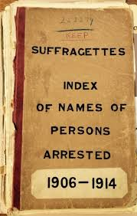
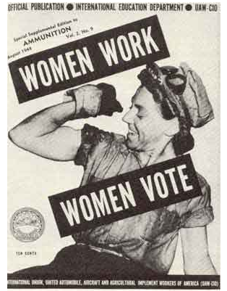
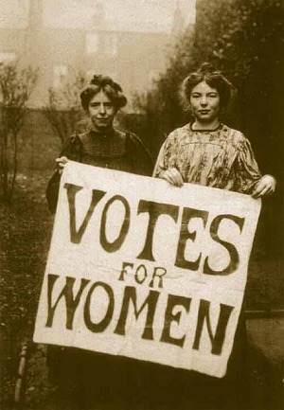
Woman Gain the Right to Vote!
Passed by Congress June 4, 1919, and ratified on August 18, 1920, the 19th amendment granted women the right to vote.

Slide 29
The Stock Market Crash of 1929
The Wall Street Crash of 1929, also known as Black Tuesday (October 29), the Great Crash, or the Stock Market Crash of 1929, began on October 24, 1929 ("Black Thursday"), and was the most devastating stock market crash in the history of the United States, when taking into consideration the full extent and duration of its after effects. The crash signaled the beginning of the 10-year Great Depression.

Slide 30
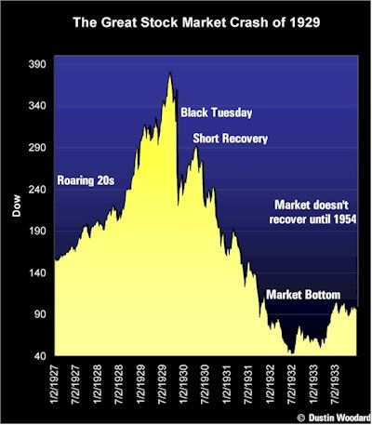

Slide 31
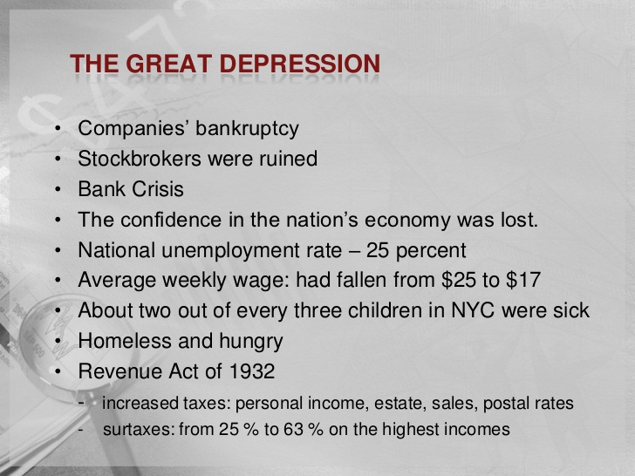
The Great Depression

Slide 32
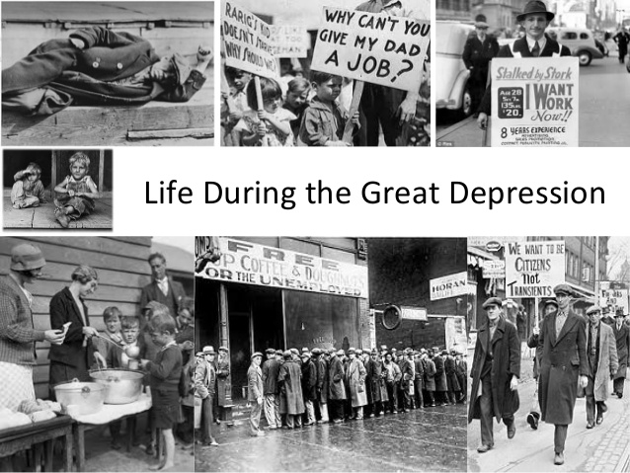
Fact Sheet for Kids on the Great Depression:
https://kidskonnect.com/history/great-depression

Slide 33
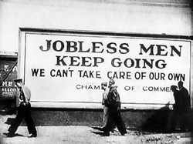
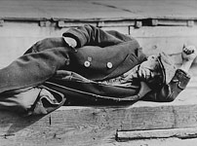
The causes of the Great Depression in the early 20th century are still a matter of active debate among economists, although the common belief is that the Great Depression was triggered by the 1929 crash of the stock market.
Timeline Written Page of The Great Depression:
http://www.pbs.org/wgbh/americanexperience/features/timeline/rails-timeline/

Slide 34
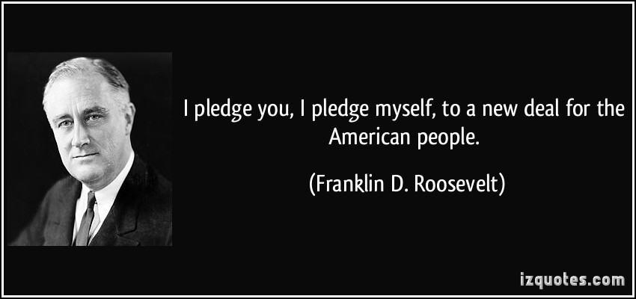
The New Deal- FDR
4 minute Video-http://www.history.com/topics/us-presidents/franklin-d-roosevelt/videos/fdr-a-voice-of-hope#

Slide 35
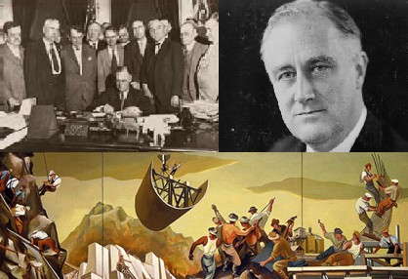
The New Deal- FDR
The New Deal was a series of programs enacted in the United States between 1933 and 1938, and a few that came later. They included both laws passed by Congress as well as presidential executive orders during the first term (1933–1937) of President Franklin D. Roosevelt. The programs were in response to the Great Depression, and focused on what historians refer to as the "3 Rs," Relief, Recovery, and Reform: relief for the unemployed and poor, recovery of the economy to normal levels, and reform of the financial system to prevent a repeat depression

Slide 36
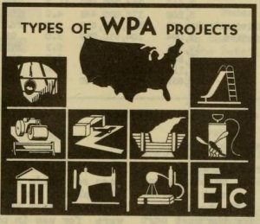
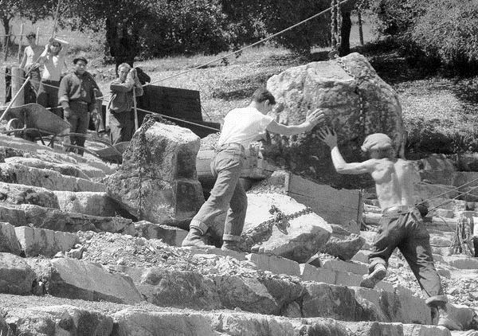
The New Deal- WPA and CCC
The Works Progress Administration was the largest and most ambitious American New Deal agency, employing millions of unemployed people to carry out public works projects, including the construction of public buildings and roads.
The Civilian Conservation Corps (CCC) was a public work relief program that operated from 1933 to 1942 in the United States for unemployed, unmarried men from relief families as part of the New Deal. CCC workers planted nearly 3 billion trees to help reforest America, constructed more than 800 parks nationwide and upgraded most state parks.

Slide 37
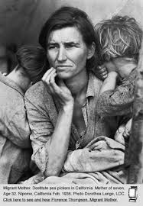
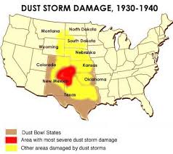
The Great Dust Bowl
Technically, the driest region of the Plains – southeastern Colorado, southwest Kansas and the panhandles of Oklahoma and Texas – became known as the Dust Bowl, and many dust storms started there. But the entire region, and eventually the entire country, was affected.
4 minute video ---https://www.youtube.com/watch?v=vXqflrkJiO4

Slide 38
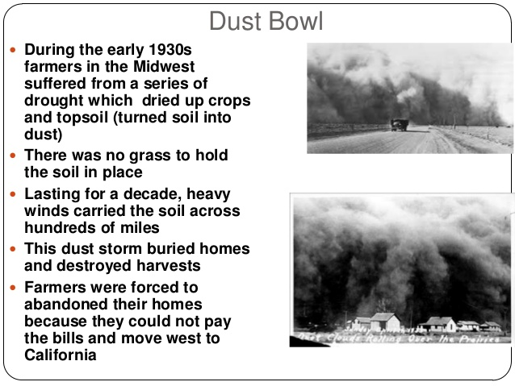

Slide 39
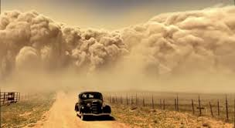
war zone

Slide 40
World War II
Need to do this section
Who fought Axis and Allies
How begun and ended
US involvement in Europe
Holocaust
Nazi Germany
D-Day
Pearl Harbor
Pacific War
Hiroshima/ Nagasaki
1950-1989- Cold War/ Korean and Viet Nam Wars/Peace Corp/JFK /Civil Rights Rosa Parks-MLK/ Space Program ? Fall of Berlin War…

